Slide 1
SIT374: Project Management
Lecture 7: Risk Management

Slide 2
Project management process groups-Activity Map
Project Plan
Acquire & manage
team
Monitor &
Control Proj.
Project
Closing
Project Charter
Scope
Time
Cost
Risk
Quality
HR
Procurement
Stakeholders
Comm.
Scope control &
verification
Stakeholders
Register
Select Sellers &
POs
Schedule control
Contract
Closing
Risk monitoring
Perform QA
Progress Reporting
Manage Stakeholders
Comm.
Contract Admin
Initiation
Planning
Executing
Mon. & Con.
Closing

Slide 3
Project Risk Management
Project management is itself risk management. All actions aim at reducing uncertainty (Risk).
Risk = uncertainty that can have a negative or positive effect on meeting project objectives.
Risk management focuses on identifying, analyzing, and responding to risk throughout the life of a project and in the best interests of meeting project objectives.
If there is so much risk in IT projects, Should organizations pursue them?

Slide 4
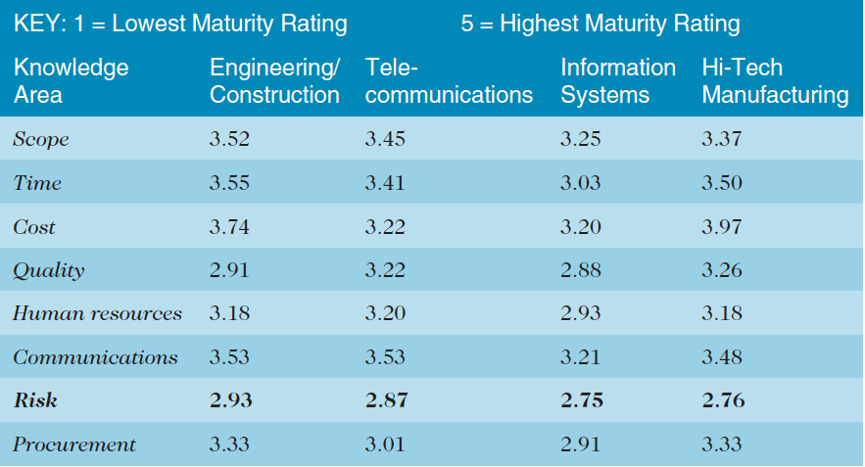
Gap in risk management
Poor rating of risk management could lead to serious project problems

Slide 5
Two Views of Risk
Negative risks
Threats
The ones we want to avoid
Factors impeding success of project
Objective: avoid, lessen, change, or accept the potential effects of risks on their projects.
Positive risks
Opportunities
Can you really manage this?

Slide 6
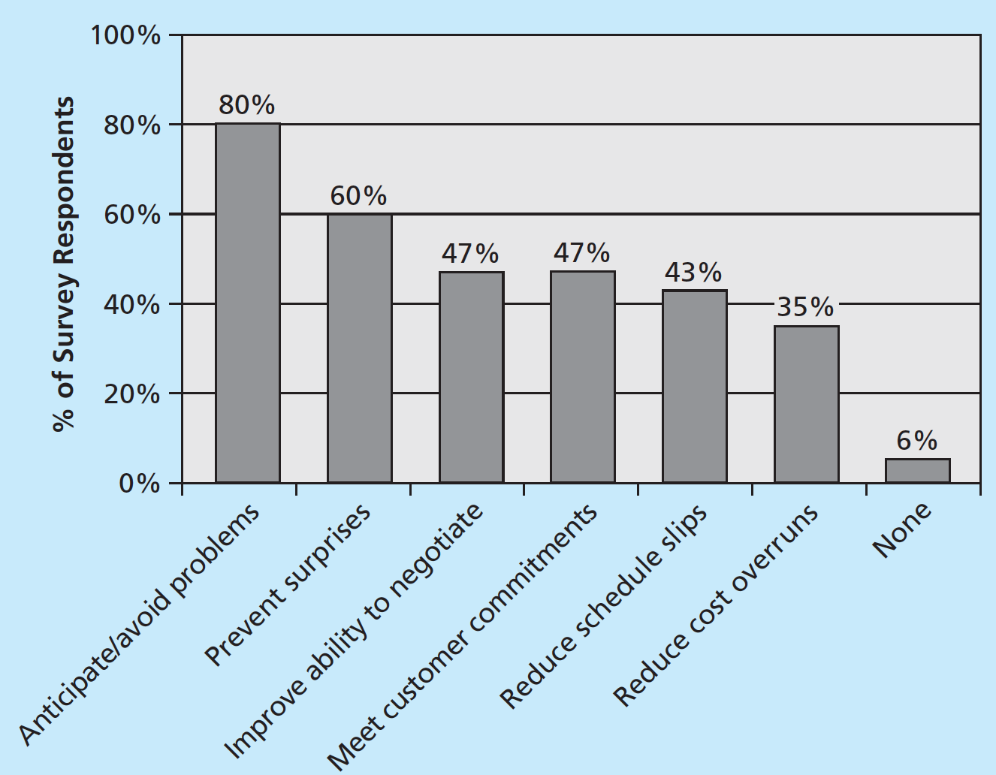
BENEFITS FROM RISK MANAGMENT
The goal of project risk management is minimizing potential negative risks while maximizing potential positive risks.

Slide 7
Attitudes towards risks
Risk utility is the amount of satisfaction or pleasure received from a potential payoff
Risk tolerance is the maximum acceptable deviation an entity is willing to accept on the project.
Risk-averse: utility rises at a decreasing rate
Risk-seeking: utility rises at an increasing rate
Risk-neutral: a balance is achieved between utility and payoff

Slide 8
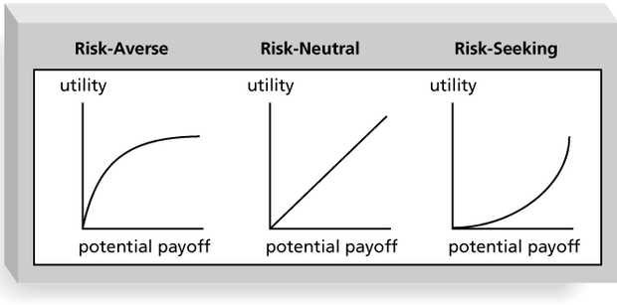
Risk Utility Function and Risk Preference

Slide 9
What can be managed
Known Risk: used to describe risks that the project team have identified and analyzed. These risks can be proactively managed.
Unknown Risks: risks that have not been identified and analyzed, cannot be managed.

Slide 10
Processes in risk Management
Identify risks
Qualitative risk analysis
Quantitative risk analysis
Plan risk response
Monitor and Control risks
Plan risk management
Monitoring and
Controlling
Planning

Slide 11
1. Plan risk management
Plan risk management is the process of defining how to conduct risk management activities for a project.
Key inputs include the project charter, stakeholder register, and organizational process assets.
The main output is the risk management plan.
Sample Risk Management Plan

Slide 12
Risk Management Plan
Main document
Methodology of risk management
Roles & responsibility
Budget and Schedule
Risk Categories (Is there a risk breakdown structure?)
Risk probability & impact: How will the probability and impact of the risk items (on triple constraints) are assessed? Quantitative or Qualitative?
Stakeholder preferences/tolerances (How will the changes affect the project?)
Notes:
College professional makes plan where to live after graduation, but if nothing worked out, he will live at home for some time. Fall back plan : live at home for some time.

Slide 13
Risk Breakdown Structure
A risk breakdown structure is a hierarchy of potential risk categories for a project
Similar to a work breakdown structure but useful when identifying and categorize risks
In addition to identifying risk based on the nature of the project or products produced, it is also important to identify potential risks according to project management knowledge areas

Slide 14
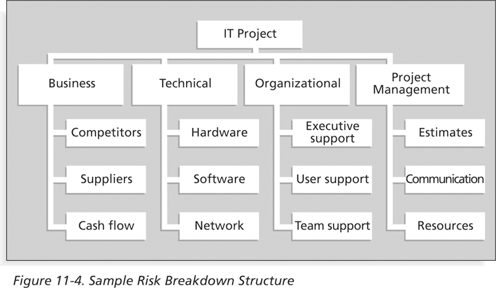
Sample Risk Breakdown Structure 1

Slide 15
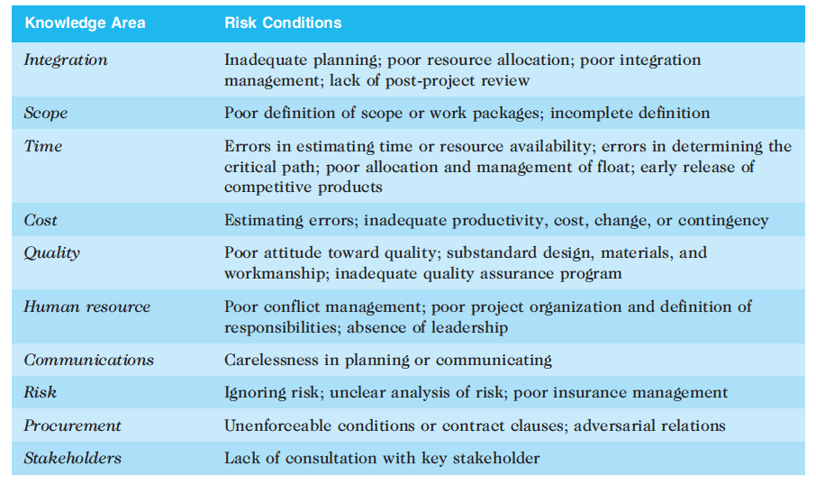
Risks vs. PMBOK

Slide 16
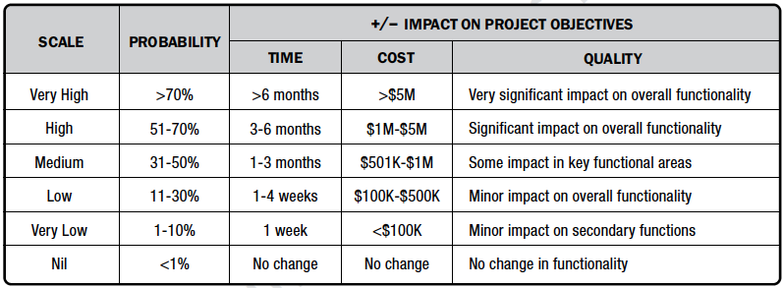
Risk probability/impact scoring scheme
Scale and definition on probability of risks and impact should be defined to facilitate subsequent risk analysis.
Notes:
College professional makes plan where to live after graduation, but if nothing worked out, he will live at home for some time. Fall back plan : live at home for some time.

Slide 17
Other aspects during planning
Contingency plan: predefined actions the project team will take if the identified risk events occur.
Fall back plan: developed for risks that have high impact on meeting project objectives, and are put into effect of attempts to reduce the risk are not effective.
Contingency Reserves: Use of reserves: are provisions held by the project sponsor or organization to reduce the risk of cost or schedule overruns to an acceptable level.
Notes:
College professional makes plan where to live after graduation, but if nothing worked out, he will live at home for some time. Fall back plan : live at home for some time.

Slide 18
2. Risk Identification
Process of understanding events that may hurt or enhance a particular project
You can not manage risks that you don’t identify
Risk identification tools and techniques
Brainstorming
The Delphi Technique
Interviewing
SWOT (Strengths, Weaknesses, Opportunities, Threats) analysis

Slide 19
Activity 1
Based on the information provided in Risk management-Activity 1, identify the risks associated with the project through SWOT method.

Slide 20
Other Risk Identification Methods
Checklists based on risks encountered in previous projects
Assumption and constraint analysis: analyze the validity of project assumptions as incomplete, inaccurate and/or inconsistent assumptions can lead to identifying more risks
Diagramming techniques: cause-and-effect, fishbone, flowcharts.

Slide 21
Risk Register
The main output of the risk identification process
A risk register is:
A document that contains the results of various risk management processes and that is often displayed in a table or spreadsheet format
A tool for documenting potential risk events and related information

Slide 22
Risk Register
A database of the risks you identified
No. | 44 | 6
Rank | 1 | 2
Risk | Recruit C++ coders | Expensive materials
Description | … | ...
Category | HR | Cost
Root Cause | Skills shortage | Petrol costs rising
Triggers | Gen-Y shuns hard languages | Tight supply
Potential Responses | Recruit overseas | Source local materials
Risk Owner | HR | Cost
Probability | High (65%) | Mediam (50%)
Impact | High – delay project | Low
Status | Open | Closed

Slide 23
3. Qualitative Risk Analysis
Assess likelihood/impact of identified risks to determine
Magnitude
Priority
Risk quantification tools
Probability/impact matrices
Top ten risk item tracking
Expert judgment

Slide 24
Probability/Impact Matrix
A probability/impact matrix or chart lists the relative probability of a risk occurring on one side of a matrix or axis on a chart and the relative impact of the risk occurring on the other
Based on the established probability/impact scoring scheme, list the risks and then label each one as high, medium, or low (or in numeric value) in terms of its probability of occurrence and its impact if it did occur
Deal first with those risks in the high probability/high impact cell

Slide 25
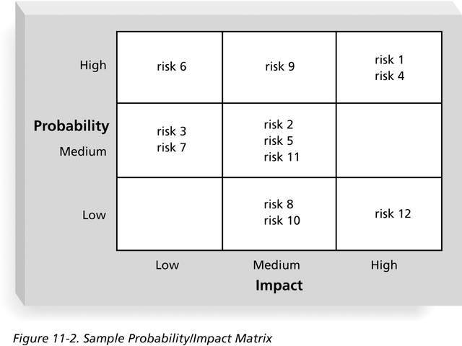
Sample Probability/Impact Matrix 1

Slide 26
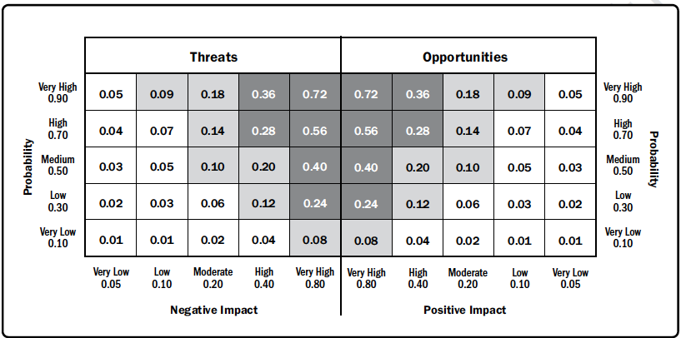
Sample Probability/Impact Matrix 2

Slide 27
Top Ten Risk Item Tracking
Top Ten Risk Item Tracking is a qualitative risk analysis tool that helps to identify risks and maintain an awareness of risks throughout the life of a project
Establish a periodic review of the top ten project risk items
List the current ranking, previous ranking, number of times the risk appears on the list over a period of time, and a summary of progress made in resolving the risk item

Slide 28
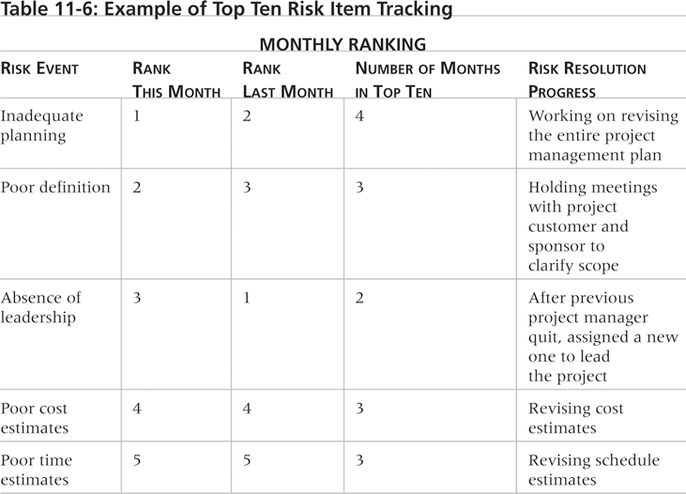
Example of Top Ten Risk Item Tracking

Slide 29
Watch List
A watch list is a list of risks that are low priority, but are still identified as potential risks
Qualitative analysis can also identify risks that should be evaluated on a quantitative basis

Slide 30
4. Quantitative Risk Analysis
Done with qualitative risk analysis
Large/complex projects often require extensive quantitative risk analysis
Techniques include
Decision tree analysis
Simulation
Sensitivity analysis

Slide 31
Decision Trees and Expected Monetary Value (EMV)
A decision tree is a diagramming analysis technique used to help select the best course of action in situations in which future outcomes are uncertain
Estimated monetary value (EMV) is the product of a risk event probability and the risk event’s monetary value

Slide 32
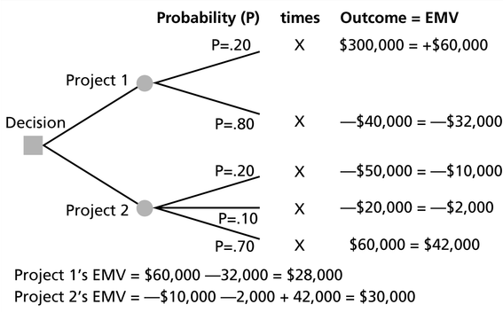
Expected Monetary Value (EMV)

Slide 33
Activity 2
Based on the information provided in Risk management-Activity 2,
Construct a decision tree to represent the two paths and their respective probabilities and outcomes.
Calculate the EMV for each development path.
Based on the EMV, which development path should DataTech Solutions choose?

Slide 34
Simulation
Simulation uses a representation or model of a system to analyze the expected behavior or performance of the system
To use a Monte Carlo simulation, you could have three estimates (most likely, pessimistic, and optimistic) plus an estimate of the likelihood of the estimate being between the most likely and optimistic values
Monte Carlo analysis simulates a model’s outcome many times to provide a statistical distribution of the calculated results
Predicts the probability of finishing by a certain date or that the cost will be equal to or less than a certain value

Slide 35
Steps of a Monte Carlo Analysis
Assess the range for the variables being considered, e.g., gather most likely, optimistic and pessimistic time estimates for each task
Determine the probability distribution of each variable
Optimistic 8 weeks, most likely 10 and pessimistic 15
For each variable, select a random value based on the probability distribution
20% chance between 8 and 10 weeks, 80% between 10 and 15
Run a deterministic analysis or one pass through the model
Repeat steps 3 and 4 many times to obtain the probability distribution of the model’s results – usually between 100 to 1,000 iterations

Slide 36
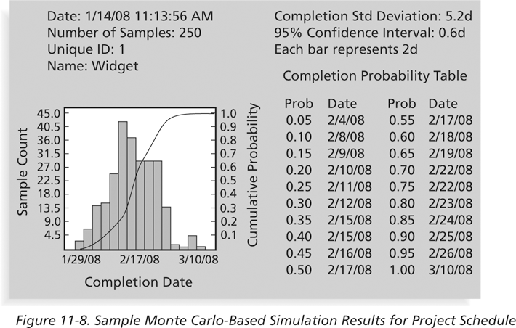
Sample Monte Carlo Simulation Results for Project Schedule

Slide 37
Activity 3
Based on the information provided in Risk management-Activity 3,
Describe how you would set up the Monte Carlo simulation to estimate the project completion time.
Explain what information you would derive from the Monte Carlo simulation results and how it would be beneficial for managing the project.
Are you able to run the simulation and plot the results?

Slide 38
Sensitivity Analysis
Sensitivity analysis is a technique used to show the effects of changing one or more variables on an outcome
E.g.: Used to determine what the monthly payments for a loan will be given different interest rates or periods of the loan, or for determining break-even points based on different assumptions
Excel, is a common tool for performing sensitivity analysis

Slide 39
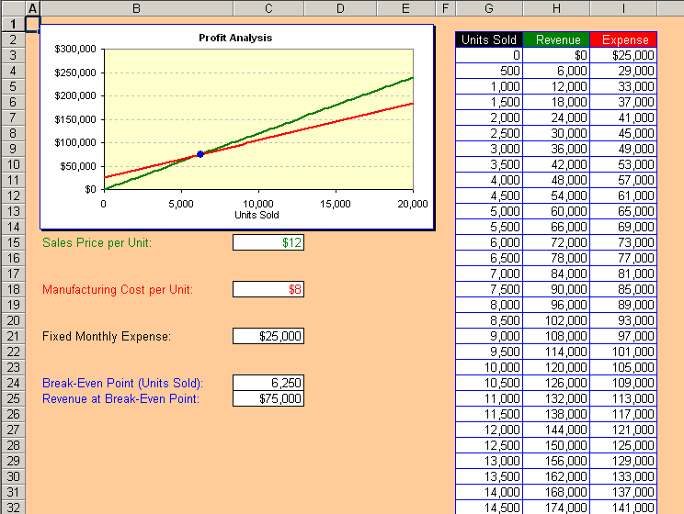
Sample Sensitivity Analysis for Determining Break-Even Point

Slide 40
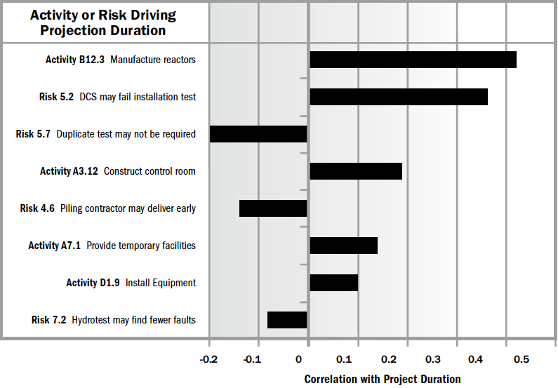
sensitivity analysis for correlation

Slide 41
5. Risk Response Planning
After identifying and quantifying risks, you must decide how to respond to them
Four main response strategies for negative risks:
Risk avoidance – don’t use h/w or s/w if unfamiliar with them
Risk acceptance – prepare for risk with backup plan or contingency reserves
Risk transference – to deal with financial risk exposure, a company may purchase special insurance for specific h/w needed for a project. If h/w fails, insurer has to replace it.
Risk mitigation – reduce probability of occurrence e.g., use proven technology, buy maintenance or service contract

Slide 42
Risk Response Planning
Four main response strategies for positive risks:
Risk exploitation – take actions to make sure it happens
Risk sharing – transfer ownership of opportunity
Risk enhancement – increase its probability/impact.
Risk acceptance – acknowledge its existence but no proactive action is taken

Slide 43
Residual and Secondary Risks
Residual risks are risks that remain after all of the response strategies have been implemented
Even though used stable h/w platform, it still may fail
Residual risks are a direct result of implementing a risk response
Responding to risk A may lead to the new risk B

Slide 44
6. monitor/control risk
Monitoring/Controlling risk is the process of implementing, monitoring risk response plans, and evaluating the effectiveness of the project.
The main outputs include:
Project document/plan updates
Change requests

Slide 45
Results of Good Project Risk Management
Unlike crisis management, good project risk management often goes unnoticed
Well-run projects appear to be almost effortless, but a lot of work goes into running a project well
Project managers should strive to make their jobs look easy to reflect the results of well-run projects

Slide 46
Activity 4
Based on the information provided in Risk management-Activity 4,
Try to identify risks based on assumptions and constraints.
Conduct risk analysis in terms of probability and impact.

Slide 47
Summary
Risk management
Plan
Identify risks
Qualitative analysis
Quantitative analysis
Risk response
Monitor/control risks

Slide 48
What’s next
Human aspect of management – HR, stakeholder and communication

